Slide 1
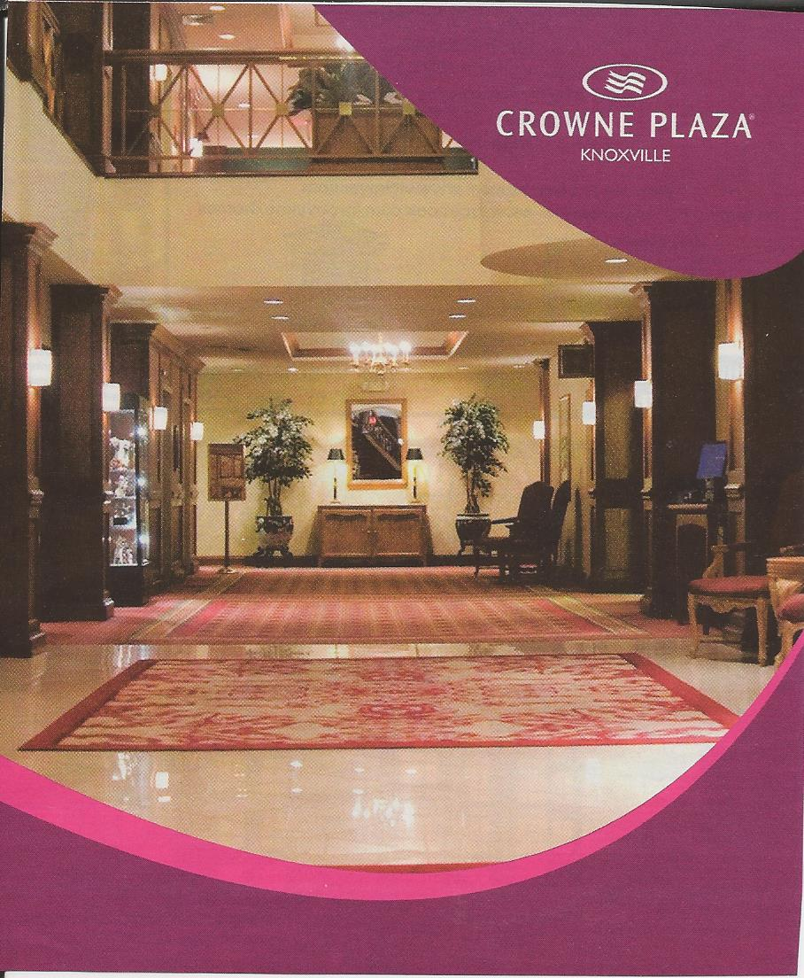
VVV Reunion July 17-20, 2014 Knoxville, Tennessee

Slide 2
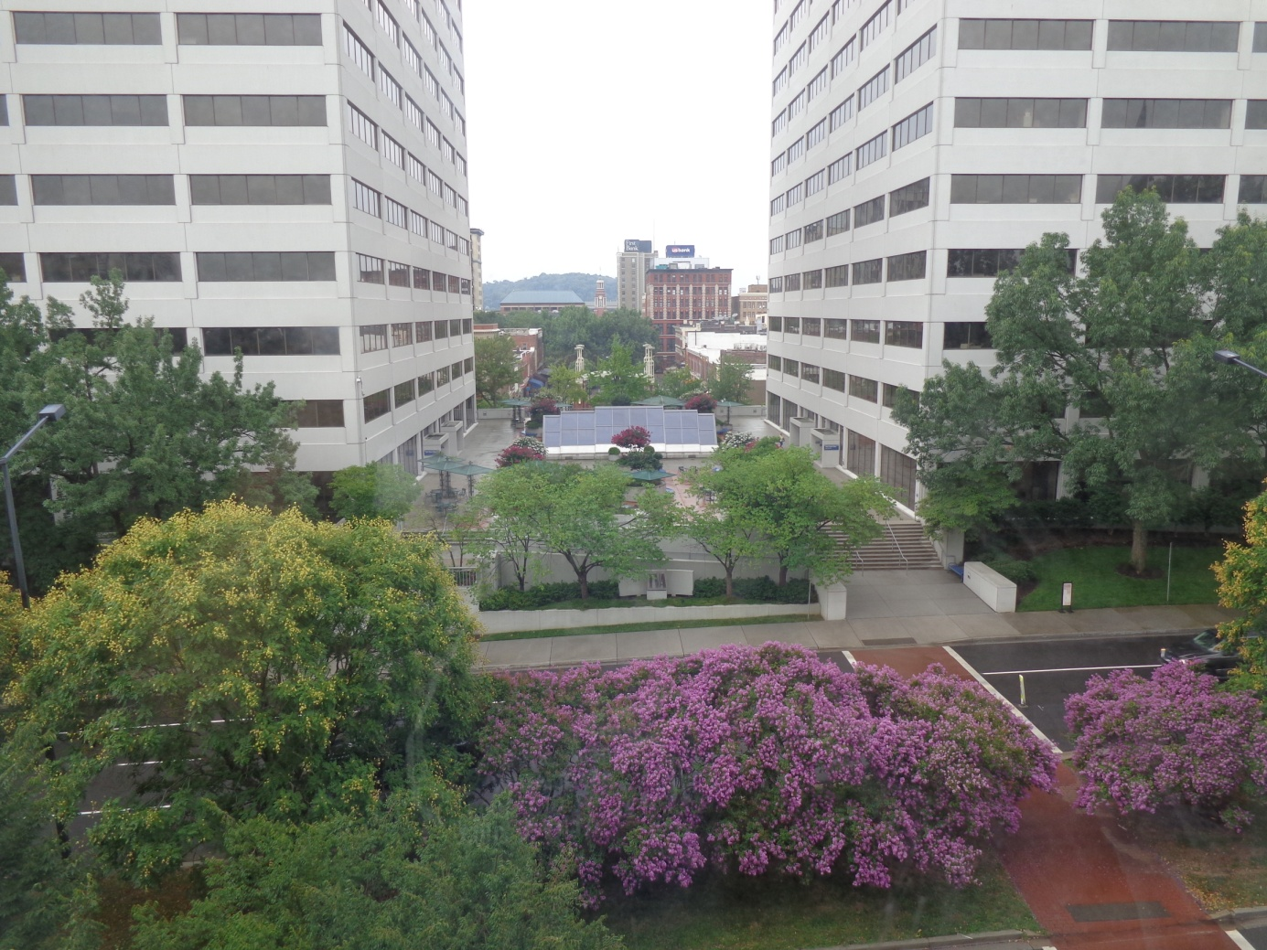
The location for the 2014 VVV Reunion was the beautiful Crowne Plaza Hotel
Located in downtown Knoxville, Tennessee.
Below is a view from the 5th floor.

Slide 3
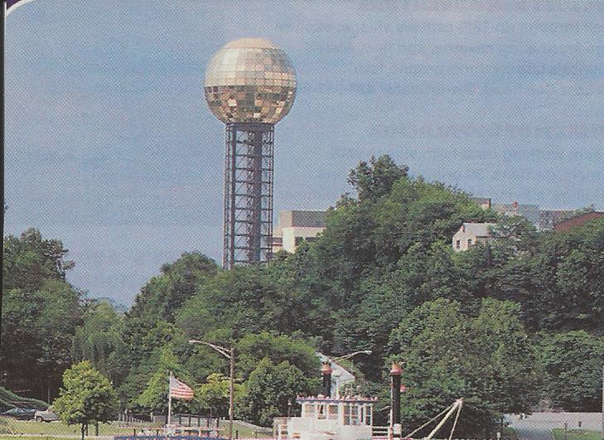
One of the main attractions in Knoxville is the Sunsphere.
A “must see” if you like heights.
Many of the
VVV cousins
rode to the
top to enjoy
the view.
Designed by the Knoxville architectural firm Community Tectonics, the Sunsphere was created as the theme structure for the 1982 World's Fair.
In its original design, the sphere portion was to have had a diameter of 86.5 feet (26.4 m) to represent symbolically the 865,000-mile (1,392,000 km) diameter sun. The tower's window glass panels are layered in 24-karat gold dust and cut to seven different shapes. It weighs 600 tons and features six double steel truss columns in supporting the seven-story sphere.^{[1]} The tower has a volume of 203,689 cubic feet (5,767.8 m³) and a surface of 16,742 square feet (1,555.4 m²).[ The 4th level of the Sunsphere houses the Observation Deck. It offers a 360-degree view of the original 1982 World's Fair site (now World's Fair Park), downtown Knoxville, the Tennessee River, the University of Tennessee, and the Smoky Mountains.

Slide 4
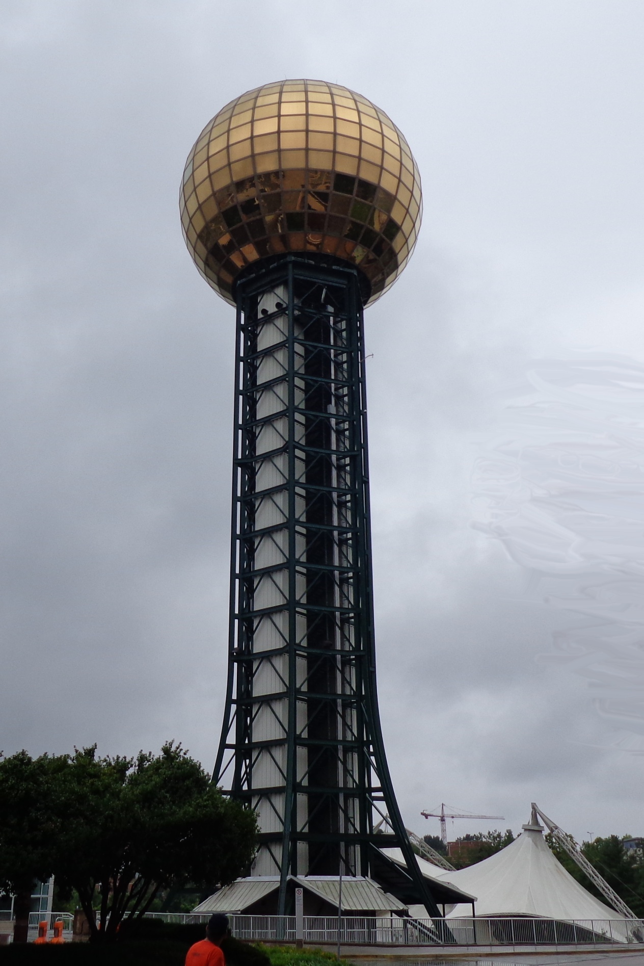

Slide 5
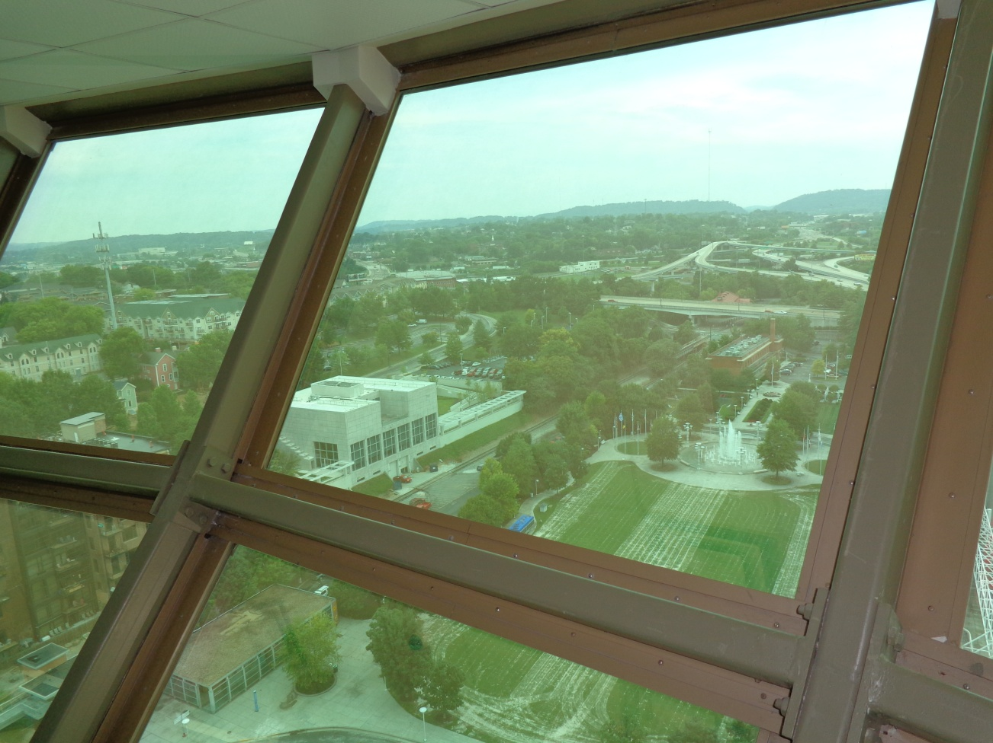
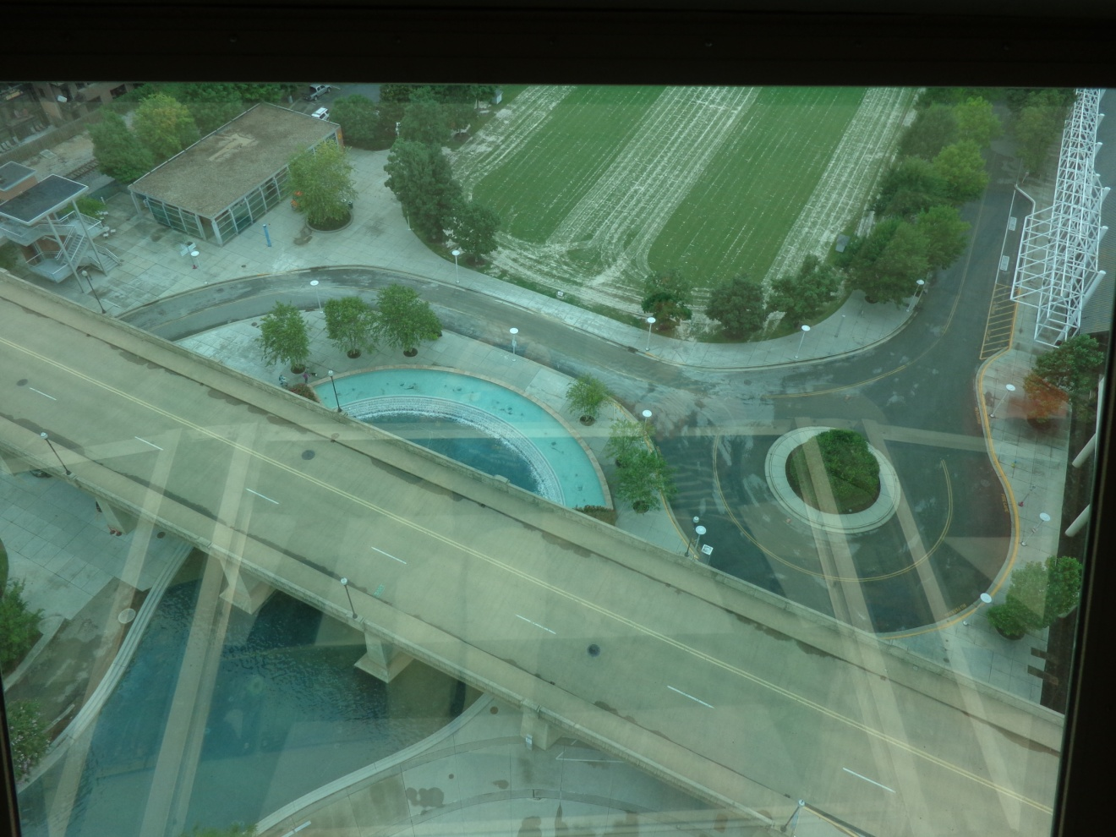

Slide 6
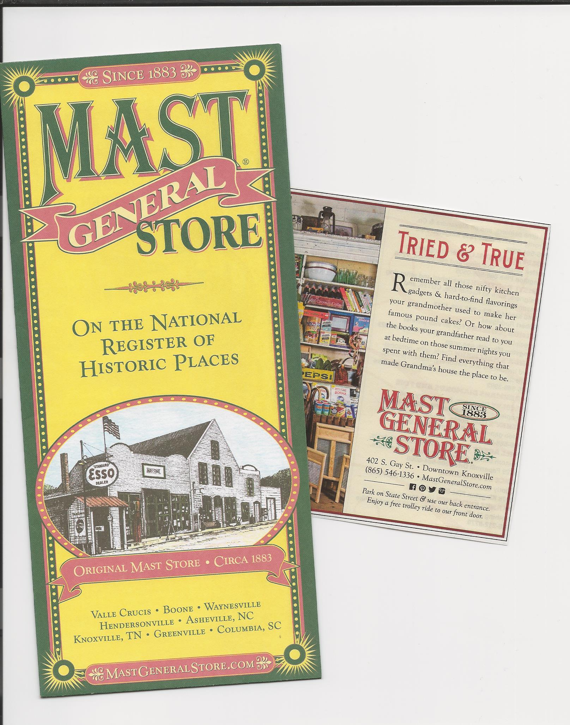
Another popular place to visit in downtown Knoxville
is the Mast General Store.

Slide 7
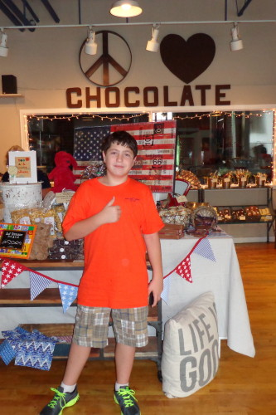
Don’t forget the Chocolate Factory !!

Slide 8
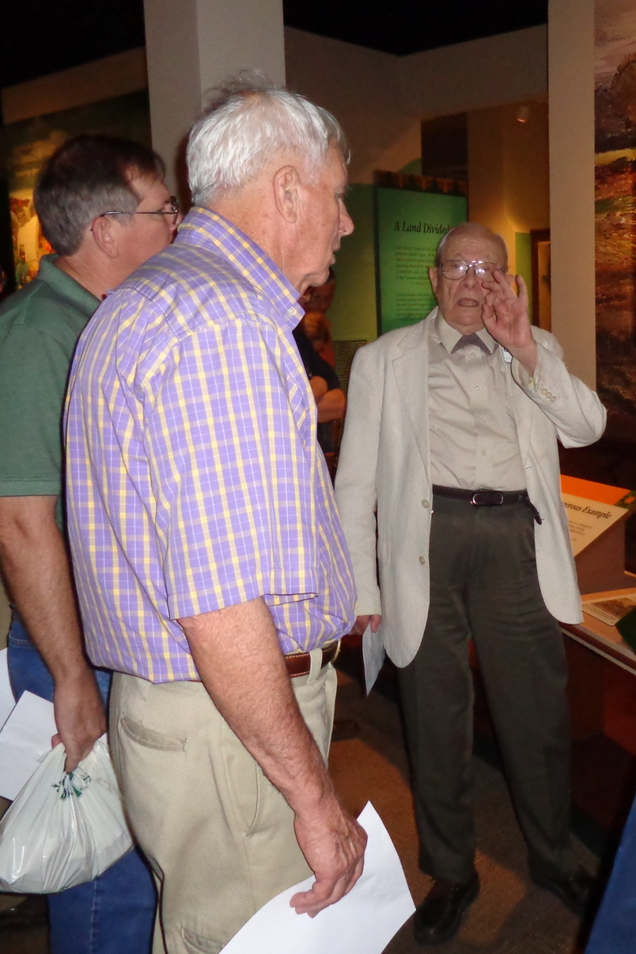
One of the highlights of the reunion was a visit to the East Tennessee Historical Society and tour of the Museum.
Our host was a charming fellow by the name of George who told us stories about Knoxville and East Tennessee. And then took us on a tour of the Museum and told more stories.

Slide 9
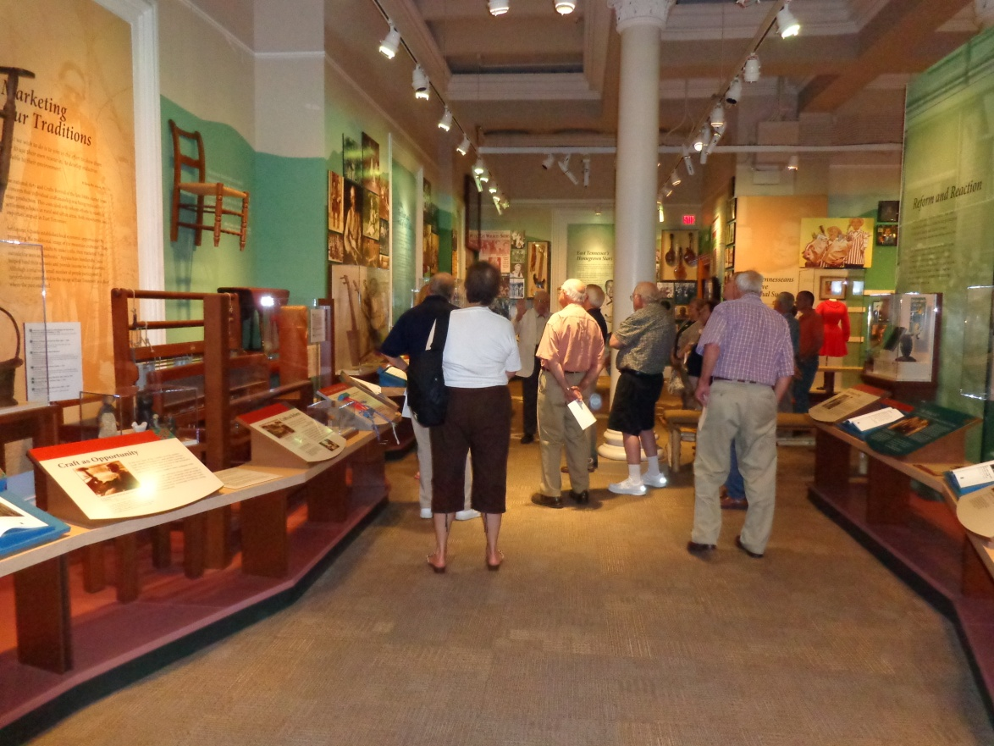
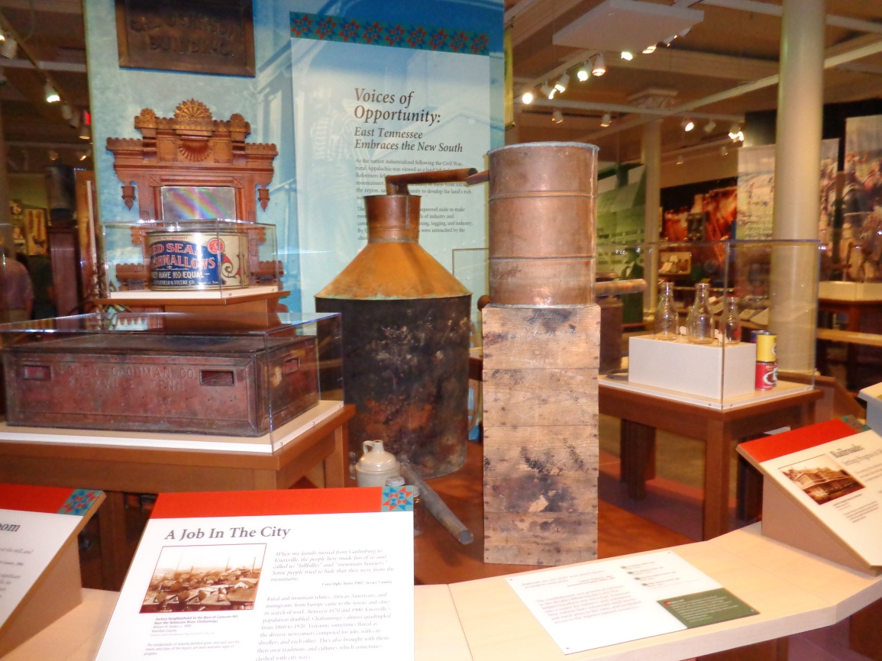
Below – a moonshine still.

Slide 10
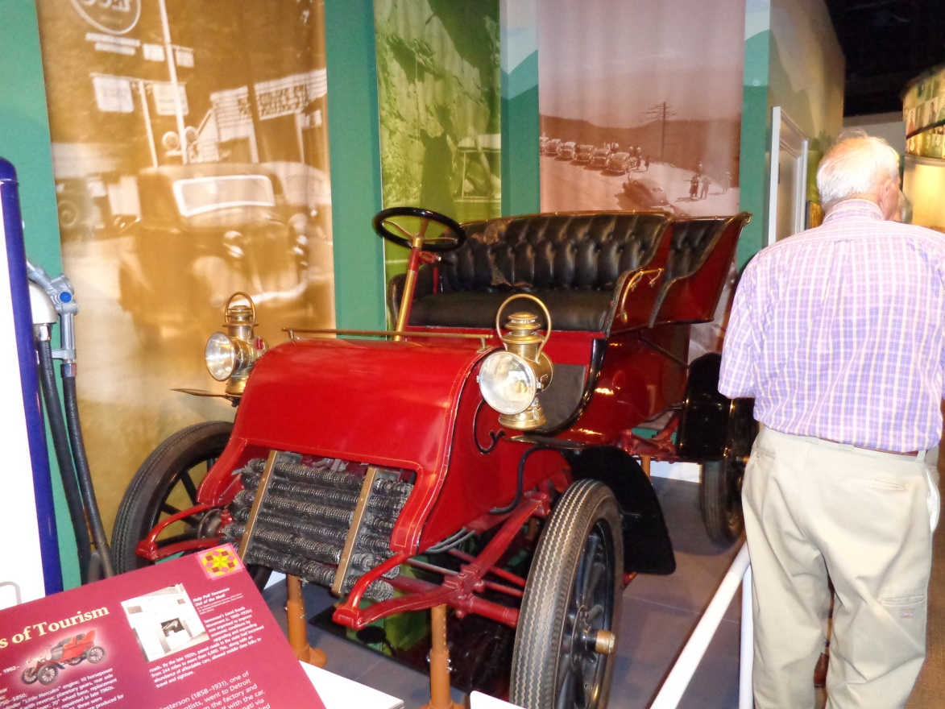
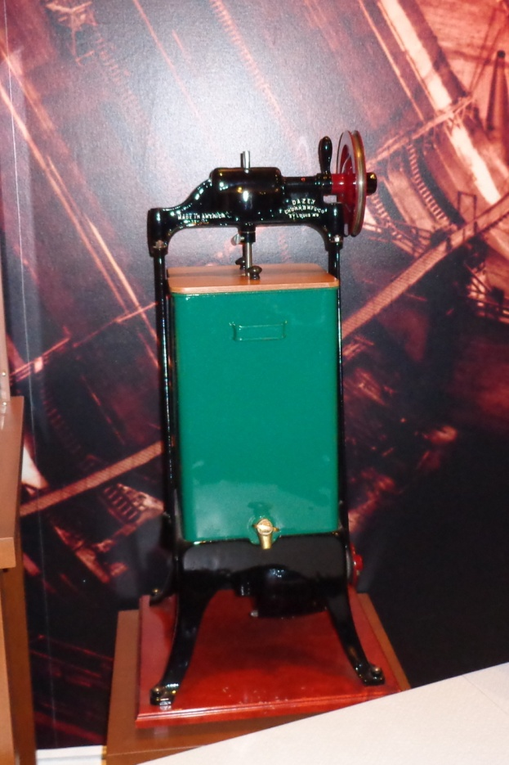
An invention
welcomed by the
ladies, after electricity
was available.
An electric butter churn.

Slide 11
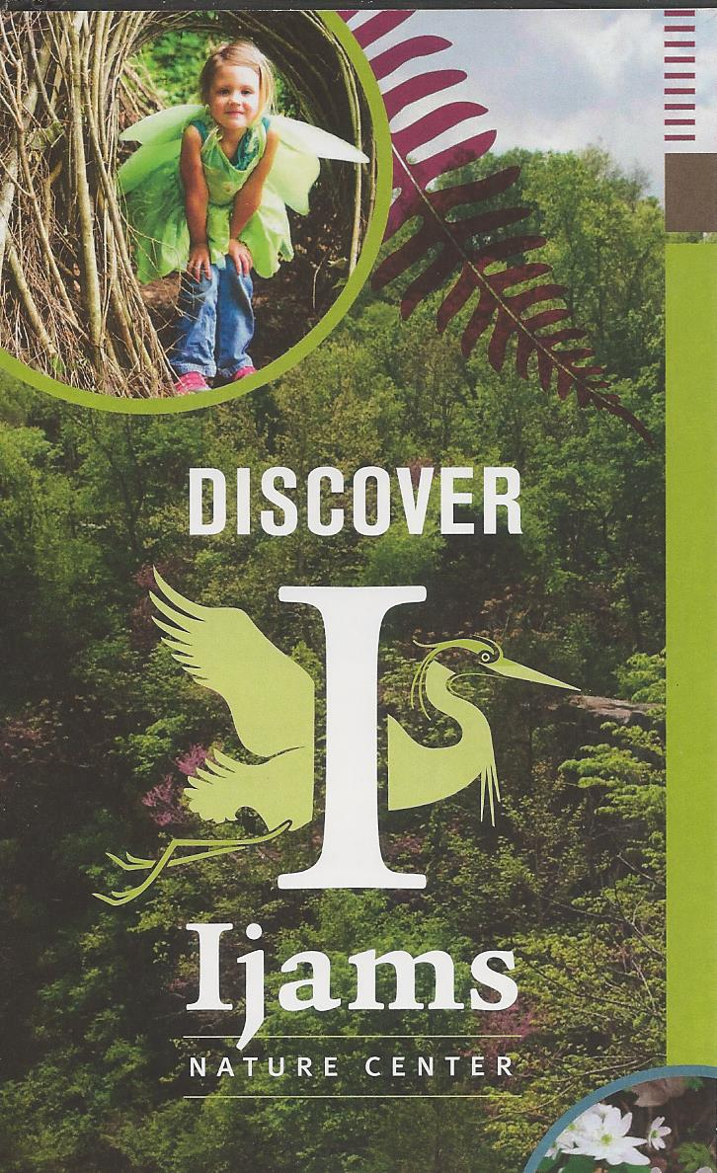
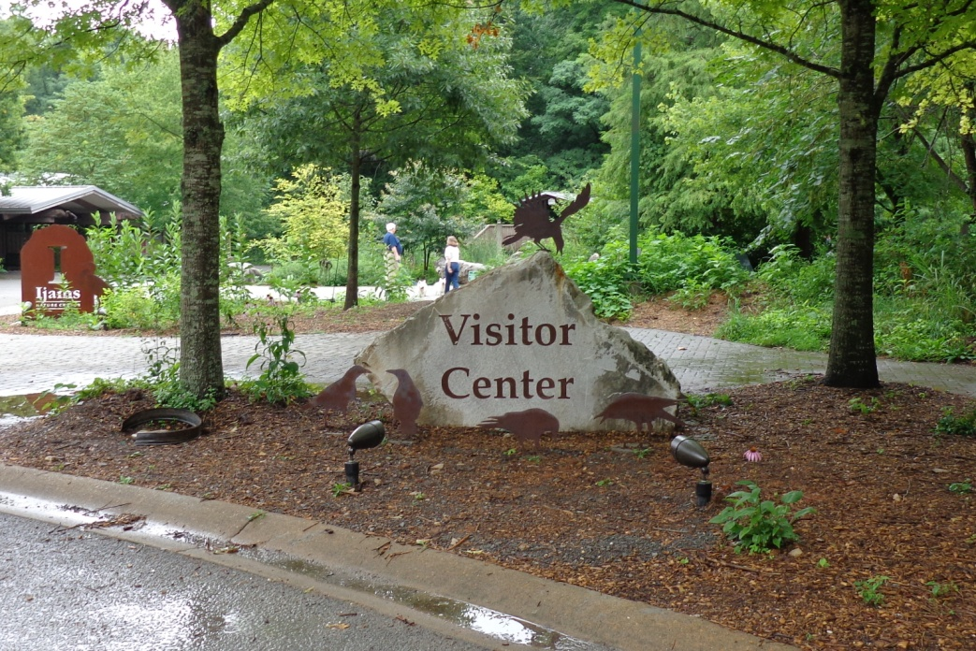
Another wonderful program was held at the Ijams
Nature Center. Although we were in and out of rain,
the program and the nature walk were very enjoyable.

Slide 12
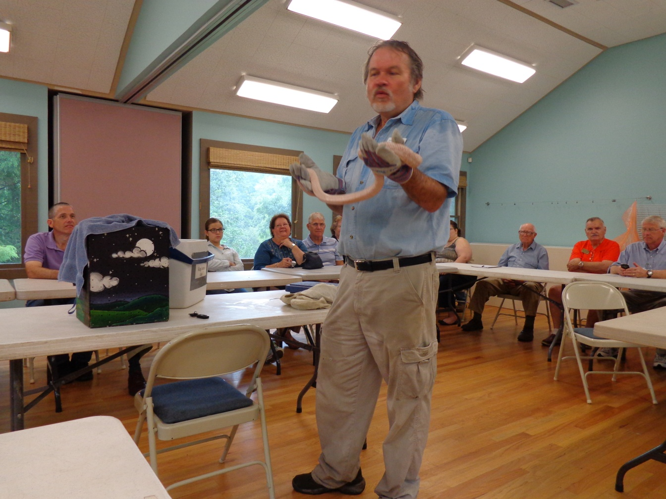
Lyn Bales introduced us to an albino corn snake. It was found living in a ladies basement. Probably for its whole life. It is very hard for an albino snake to live in the wild,
so he was sent to the nature center.
We couldn’t pet him because we could give him germs.

Slide 13
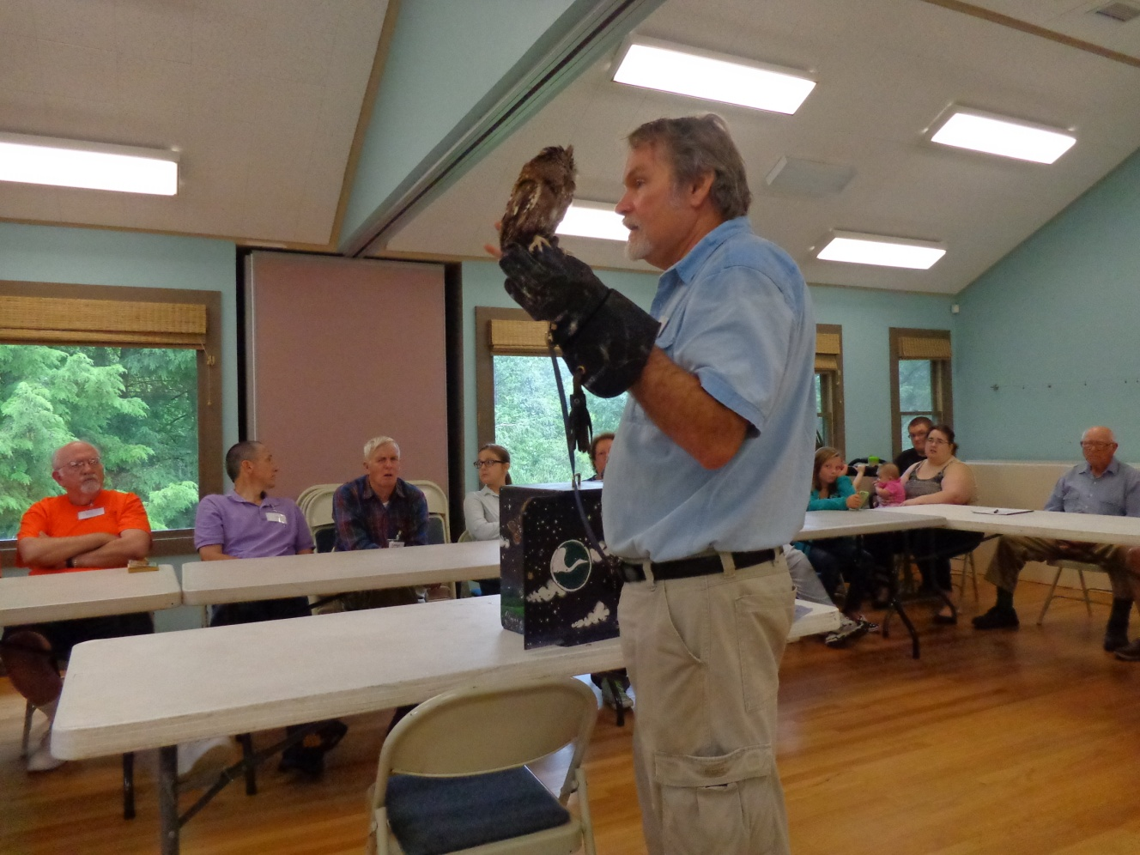
We also met a little one-eyed owl. He was sent to the Nature Center because he has trouble with depth perception and flying.
The animals at the Nature Center are there because they need help to survive. For instance, the three-legged turtle in the aquarium.
And the USP man makes periodic deliveries of frozen
mice to feed the snakes and birds of prey.

Slide 14
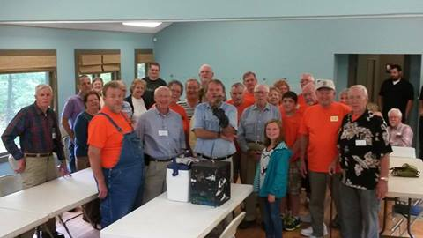
The cousins are getting ready for a nature walk
while the caterer sets up the lunch.

Slide 15
For more photos, see the 2014 “Portraits”
And Please click “Esc” to exit from this program.

